Slide 1
IAOPA World Assembly
EUROCAE - UAS standards
Christian Schleifer-Heingärtner
Secretary General
New Zealand, 27 March 2018

Slide 2

Inputs for Standardisation
Membership
R&D
SESAR JU
Regulators (national, EASA)
Manufacturers
Organisations
(ECTL, ECA, IFATCA, IAOPA)
Service Providers
International Bodies
ICAO
Other SDO
RTCA, SAE
ESO
Notes:
Every full member can initiate a standardisation activity
Voluntary work force,
Consensus driven approach, open consultation in developing standards, different validation steps.

Slide 3
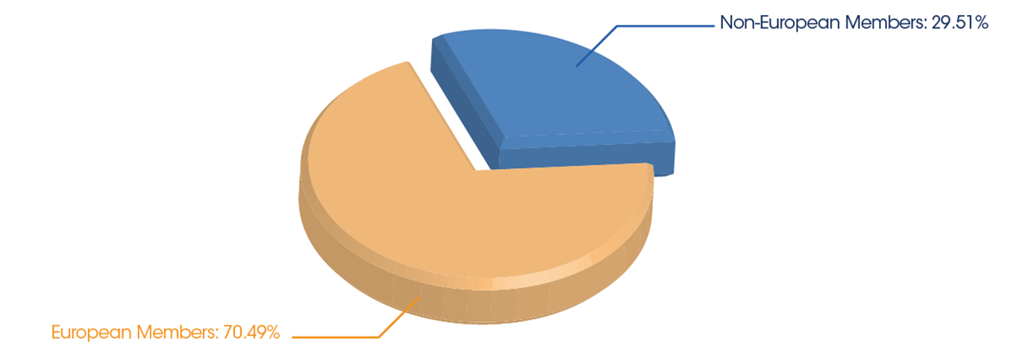
EUROCAE facts and figures
230+ Members (+10% p.a.)
  115 in 2010
38 active working groups
  26 in 2010
2000+ experts

Slide 4

EUROCAE process
Transparent and open process
Consensus driven development approach
Standards validation
Open consultation
Worldwide recognition
Worldwide application
Open for worldwide participation
By the industry – for the industry

Slide 5





Coordination

Slide 6
EASCG/EUSCG goals
harmonised implementation in support of the regulatory frame
timely availability
streamline relevant standardisation activities in Europe
new standards arising from the deployment and implementation process
performance-based regulation

Slide 7
EA/USCG Tasks & Deliverables
develop, monitor and maintain an overarching European standardisation and regulatory RDP
https://www.eurocae.net/about-us/euscg/
facilitate the sharing of work among the SDOs, avoiding the risk of overlaps and gaps
monitor all relevant processes, resource availability and other related risks and issues
provide a forum to manage specific issues and resolution of conflicts
advise the EC and EASA and other regulators on standardisation matters and standardisation issues

Slide 8




Global coordination
50 % joint WGs
10 % joint WGs

Slide 9


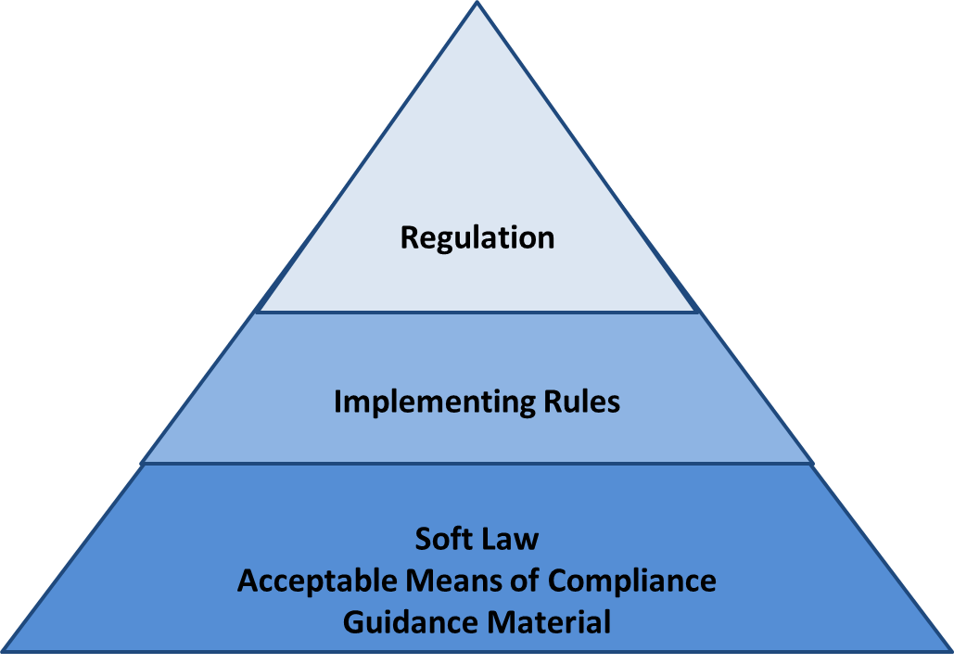
Regulation – Standard
PB regulations by FAA/EASA and ICAO
  Reference to industry standards
standardisation reaction to regulation
forward looking
  in anticipation of regulatory requirements
referenced by the regulator
  EASA, EU Leg, FAA, ICAO
ETSO – MOPS, SW, Environment
Notes:
Regulation and implementing rule gives the strategic direction and sets the safety level
Bucharest and Warsaw declarations to work with SDOs

Slide 10





R&D-standardisation-deployment
R&D Standardisation Deployment and Regulation
Notes:
R&D to Standard and regulation – deployment
Industry and SDO stakeholders to define the “how to comply” use EUROCAE Stds as Acceptable Means of Compliance
Standards are the only way avoid divergences between the major R&D programs (Carats, NextGen and SESAR)

Slide 11

Domains of activities
Avionics
Communication
Navigation
Surveillance
ATM Systems
Airports
SWIM
Security
AIS / MET
RPAS & General Aviation
Miscellaneous
  Fuel cells
  Space

Slide 12
Specific topics of interest
Current GA-relevant activities and EDs
  WG-49 Mode S
  WG-51 ADS-B
  WG-75 TCAS
  WG-105 UAS
  WG-107 DME/DME
  WG-28/62
  Galileo, GNSS, SBAS
  WG-14/31
  Environment, Lightning
  WG-72 Cyber security
  WG-106 EFB
  WG-79 EVS/SVS
  WG-98 ELT
  WG-100 Remote tower
  …

Slide 13
WG-105 UAS
Scope and Objective
Develop the necessary standards to enable safe integration of all classes of UAS into all classes of airspace
Consider emerging regulatory proportionate risk based approach and related UAS Categories, with due consideration of the industry requirements
Matrix structure
  Operations centric, risk based
Ambitious work programme
  Over 30 deliverable in short timescale
Maintain coordination with
  EASA, JARUS, ICAO Other involved bodies (SJU, RTCA, ASTM…)

Slide 14
WG-105 UAS Structure
Steering Committee (SG-0)
(Co-chairmen, Secretaire, FT leads, TPM)
FT DAA
(SG-10)
FT C3&S
(SG-20)
FT UTM
(SG-30)
FT D&AW
(SG-40)
FT ERA
(SG-50)
FT SORA
(SG-60)
SG- 11 DAA
A-C
SG-21
C2 Link
SG-31
UTM
SG-41
1309
SG-51
A&ER
SG-61
SORA
SG-12
DAA
A-G
SG-22
C2 Spect.
SG-32
IDN
SG-42
RPS
SG-52
ATOL
SG-13 DAA
VLL
SG-23
C2 Secu.
SG-33
GEO
SG-53
Auto Taxi

Slide 15
6 Focus Areas working in a
New Regulatory Environment
WG-105 to essentially deal with Specific & Certified
Support from WG-105 … |  |  |  | … to Regulators
 | Open | Specific | Certified
DAA | Rec stand, pending on SORA and U-Space |  | MASPS/MOPS | ETSO & AMC
C3&S | Guidance on Comm, Spectrum and Security. Rec standards pending on SORA and U-Space development |  | MASPS/MOPS | ETSO & AMC
UTM | 1st initiative: Standards for U-Space (U-1) on e-identification and geo-fencing |  | / | AMC
D&AW |  |  | 1st step PoW then Supporting Standards. First topics: RPS-ATI MASPS & AMC 1309 inputs | AMC to CS/SC
ERA |  |  | MASPS | ETSO
SORA |  | 1st step PoW then Supporting Standards |  | Recommended Standards

Slide 16
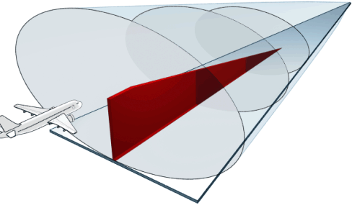

EUROCAE Role
Best industry practice
Soft law
Acceptable means of compliance
How to do and to comply
Internationally recognised

Slide 17

EUROCAE today
changing environment
changing EUROCAE
disruptive and new technologies
new and different stakeholders
competition
big picture–many players
vision and strategy
resources, participation

Slide 18
Thank you!
Christian Schleifer-Heingärtner
  Phone: +33 1 49 46 19 60
  christian.schleifer@eurocae.net

